Slide 1

Nachos Overview
Reference: http://mll.csie.ntu.edu.tw

Slide 2
Nachos
Nachos:
– Not Another Completely Heuristic Operating System
Written by Tom Anderson and his students at UC Berkeley
http://www.cs.washington.edu/homes/tom/nachos/

Slide 3
Nachos 4.0
An educational OS used to
  teach kernel design and implementation
  do experiments
Fact:
  Real hardware is difficult to handle.
  May break if handled wrong.
Approach:
  Use a virtual MIPS machine
  Provide some basic OS elements

Slide 4
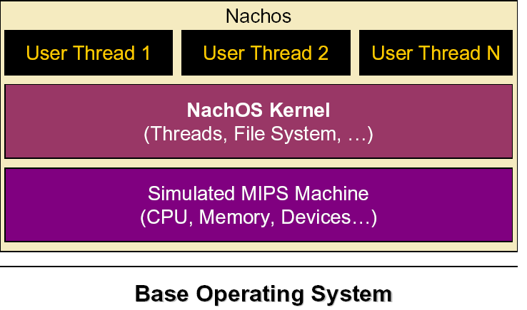
Nachos 4.0

Slide 5
Nachos 4.0
Simulates MIPS architecture on host system
(Unix /Linux/ Windows / MacOS X )
User programs need a cross-compiler (target MIPS)
  Eg. To compile user programs to MIPS on Linux
Nachos appears as a single threaded process to the host operating system

Slide 6
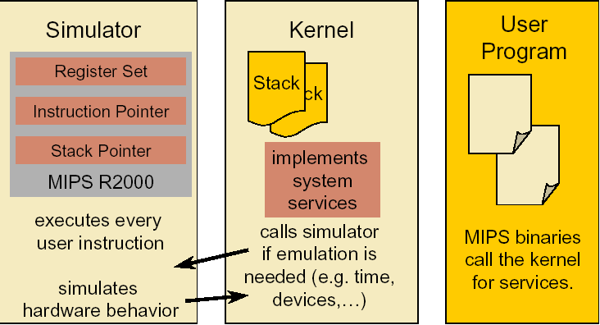
How does it work?

Slide 7
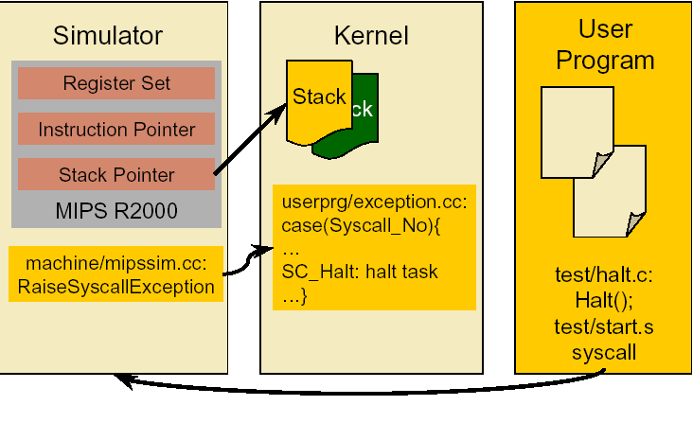
How does it work? (Cont.)

Slide 8
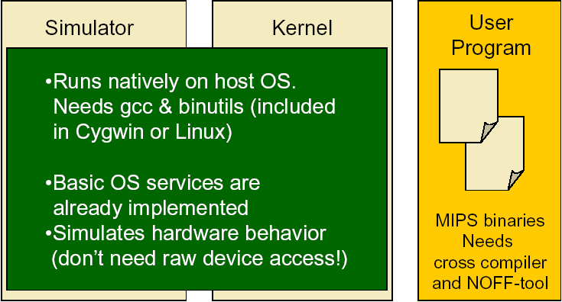
How does it work? (Cont..)

Slide 9
Introduction of Nachos
User-level processes
  How a user program is loaded and run?
System calls
  How a system call is called?
  How to implement one?
Related source files
  Which files do we need to trace and modify?

Slide 10
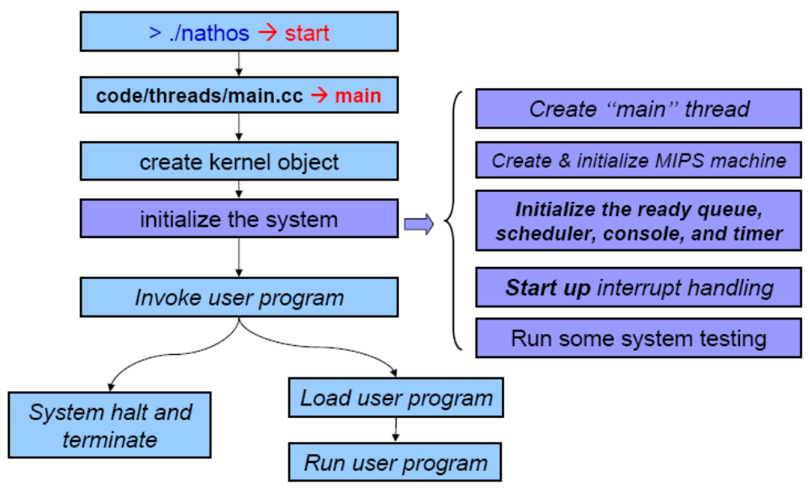
Nachos startup

Slide 11
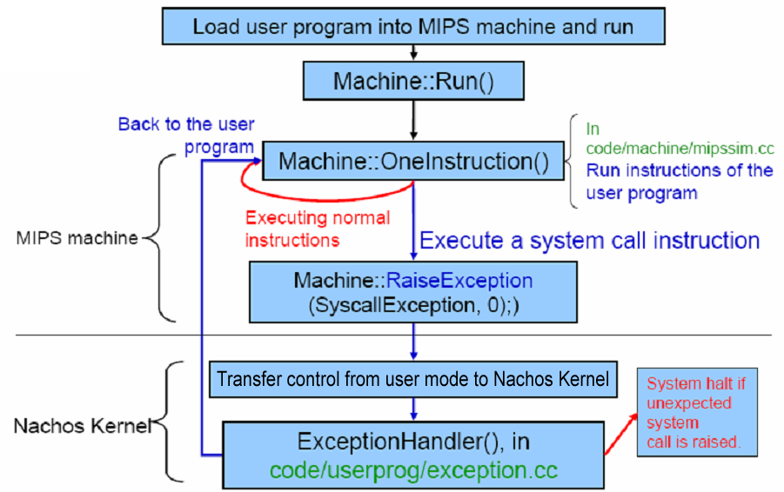
Nachos system calls

Slide 12
Exception
Transfer control from user mode to the Nachos kernel
  System call
  Divide by zero
  Access invalid memory address
  etc.

Slide 13
Setup the System
Refer to the following document:
https://www.fit.hcmus.edu.vn/~ntquan/os/setup_nachos.html

Slide 14
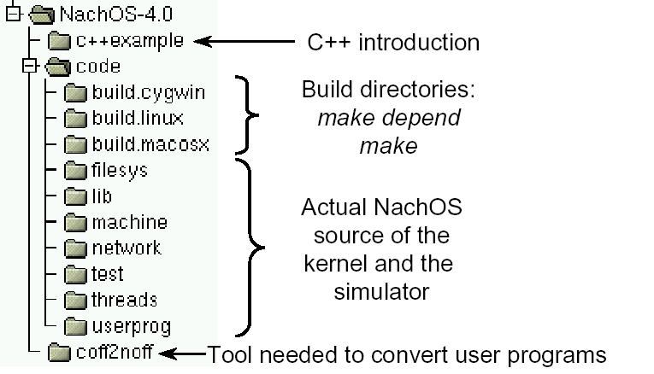
Nachos content

Slide 15
Setup the System (cont.)
You can build Nachos on Linux
  Your linux
  Virtual machine

Slide 16
Setup the System (cont.)
MIPS Cross compiler
  Nachos simulates MIPS machine
  The user program built by this compiler cannot run on Linux
Please make sure that you follow the steps in the instruction
  You should extract Nachos and the cross compiler to the same directory
  (NachOS-4.0 and usr)
  Or, user programs could not be built

Slide 17
Test files
There are some test user programs in NachOS-4.0/code/test/
  Use “make” to build them, the MIPS binary would be generated in the same directory
Use these files to test if your Nachos is properly modified and built

Slide 18
How to run
“nachos –x userprog –d u”
  Nachos binaries is in NachOS-4.0/code/build.linux/nachos
  Use –x to run the user programs
  Use –d to show debug messages
  A full list of options is under NachOS-4.0/code/lib/debug.h
Nachos would startup, load and run the user program, then halt

Slide 19
Example

Slide 20
Implementation
We use the system call “Add()” as an example
  code/test/add
  Add(42,23) returns 65
Define the system call code in code/userprog/syscall.h
  #define SC_Add 43
Declare the interface for user programs in code/userprog/syscall.h
  int Add(int op1, int op2);

Slide 21
Implementation (cont.)
Implement the system call function body for user program
  This function must put the corresponding system call code to the register, then run MIPS instruction “syscall”
  When the MIPS machine in Nachos see this command, it will run the corresponding system call
  So, the function body is implemented in MIPS assembly code/test/start.S
code/test/start.S:
.globl Add
.ent Add
Add:
addiu $2,$0,SC_Add
syscall
j $31
.end Add

Slide 22
Implementation (cont.)
Implement the real stuff in ExceptionHandler() in code/userprog/execption.cc
  “syscall” would raise an exception, and kernel use ExceptionHandler() to handle it
  The arguments of the system call is in register 4~7 of the MIPS machine, and we should put the return value to register 2
  We need to increment register PC before we return
This is the only file you need to send in this project
  Because the implementation in other files would be the same

Slide 23
Implementation (cont.)
case SC_Add:
DEBUG(dbgSys, "Add " << kernel->machine->ReadRegister(4) << " + "
<< kernel->machine->ReadRegister(5) << "\n");
int result;
// SysAdd(a,b) returns a+b
result = SysAdd((int)kernel->machine->ReadRegister(4),
(int)kernel->machine->ReadRegister(5));
DEBUG(dbgSys, "Add returning with " << result << "\n");
kernel->machine->WriteRegister(2, (int)result);
/* Modify return point */
{
/* set previous program counter (debugging only)*/
kernel->machine->WriteRegister(PrevPCReg,
kernel->machine->ReadRegister(PCReg));
/* set program counter to next instruction
(all Instructions are 4 byte wide)*/
kernel->machine->WriteRegister(PCReg,
kernel->machine->ReadRegister(PCReg) + 4);
/* set next program counter for brach execution */
kernel->machine->WriteRegister(NextPCReg,
kernel->machine->ReadRegister(PCReg)+4);
}
return;

